Slide 1
Brazil's Market Entering
Way Forward
ENIAC
Group 2:
Sree M. Elancheralathan
Anushree Balakrishnan
Sana Jradi
Michael Storm
Luis Cuneo

Slide 2
Objective
Challenge
Approach
Expansion into Brazilian market within next year
Lack of knowledge of Brazilian market
3-year contract with Magist
Notes:
Magist: service company that offers a centralized order management system to connect the Brazilian market

Slide 3
Two main concerns
Magist Expertise:
Is Magist a good/right partner?
Magist Operations:
Are deliveries fast enough? / Customer Satisfaction?

Slide 4
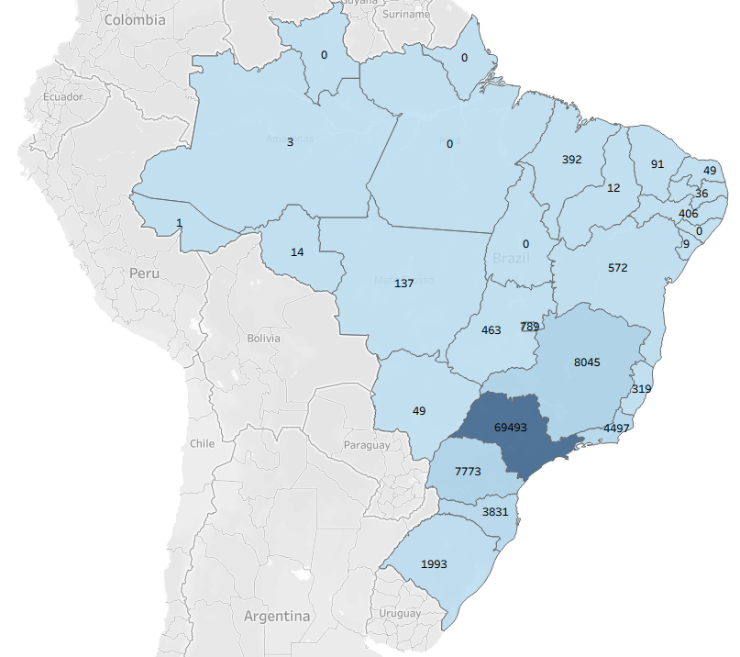
Magist - Overview
Well established company which covers the whole Brazilian territory.
Wide range of products (+70 categories)
Economy of scale
Growth in the last 2 years (99k orders in total)
Notes:
Magist: service company that offers a centralized order management system to connect the Brazilian market
Magist provides after-sales services such as stock and warehouse management, product shipment, and customer service related to the shipment
Magist has signed advantageous contracts with the marketplaces and with the Post Office, thus reducing the cost of fees and, most importantly, the bureaucracy involved in getting things started.

Slide 5
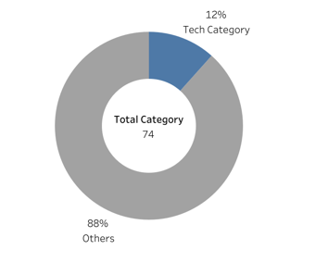
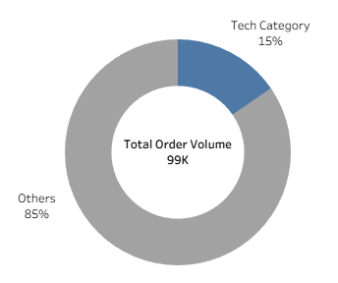
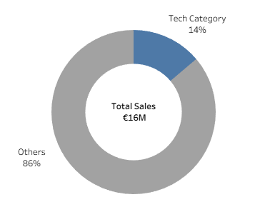

Magist – Marketplacement
- No in-depth expertise in High-Tech products -

Slide 6
Magist – Marketplacement
CONCEPT | ENIAC | MAGIST
Avg Item Price | 540 €/item | 110 €/item
Avg Order Value | 710 € | 140 €
5x
5x
Only 3% of MAGIST´s customers belong to a “VERY EXPENSIVE” segment
- Customers mainly focus on low-range price products -

Slide 7
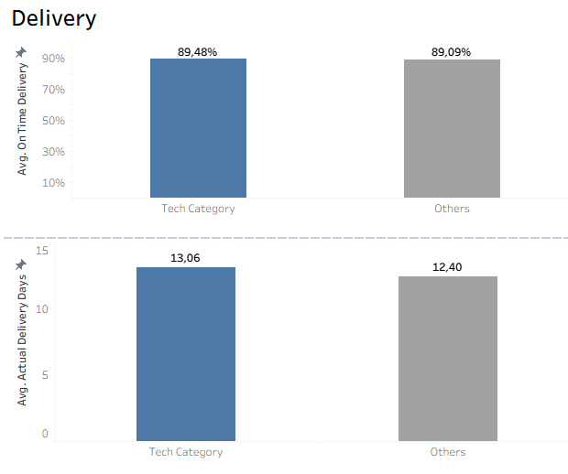
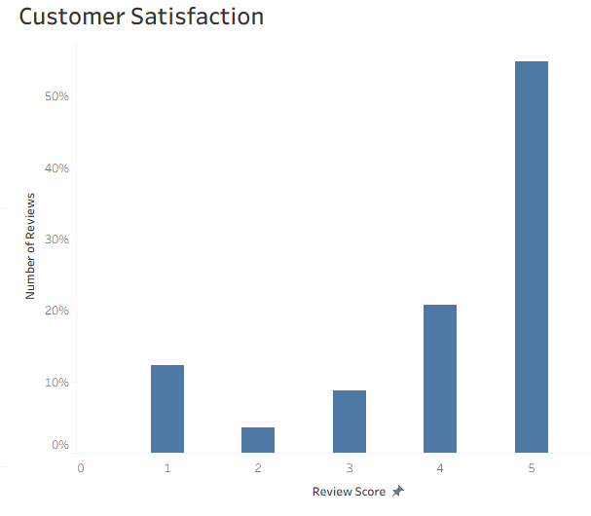


Magist – Operational Performance
90%
~75%
12,5
>15%
- Overall Operational Performance below ENIAC´s standards -

Slide 8
Recommendation
Not to sign a 3-year contract with MAGIST as is.
Find an alternative company who better fits ENIAC´s standards and values.
Where not possible, renegotiate MAGIST´s contract on yearly basis.

Slide 9
Thank You
Group 2:
Sree M. Elancheralathan - Anushree Balakrishnan - Sana Jradi - Michael Storm - Luis Cuneo

Slide 10
Backup

Slide 11
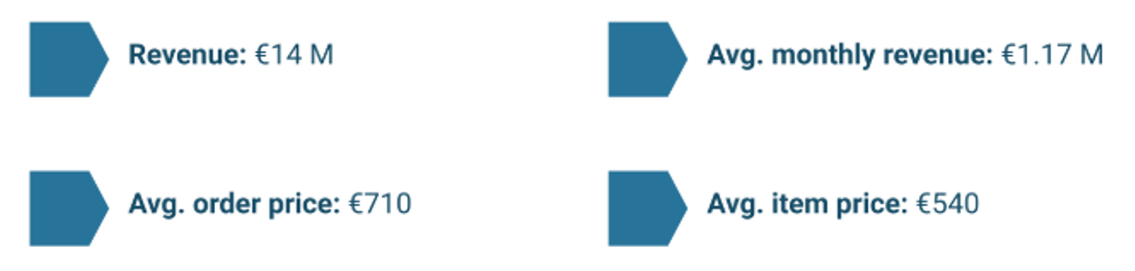
ENIAC - Fact & Figures

Slide 12
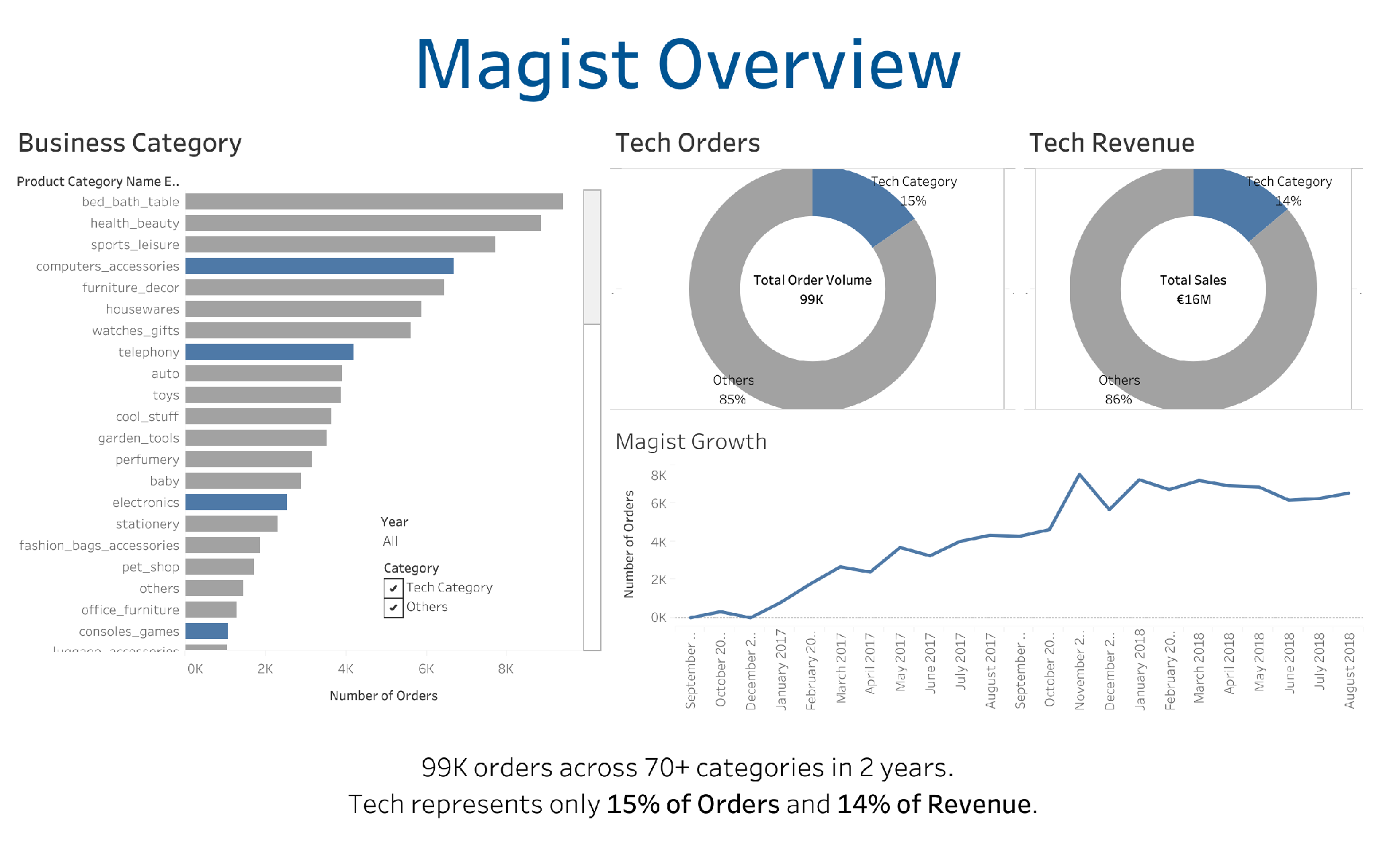

Slide 13
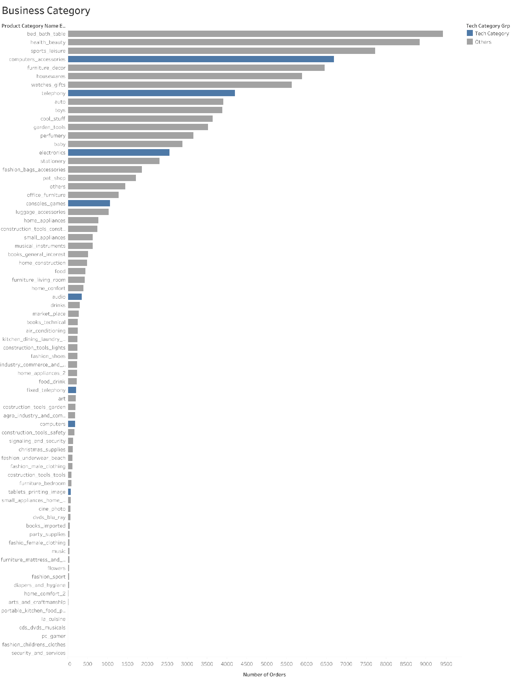

Slide 14
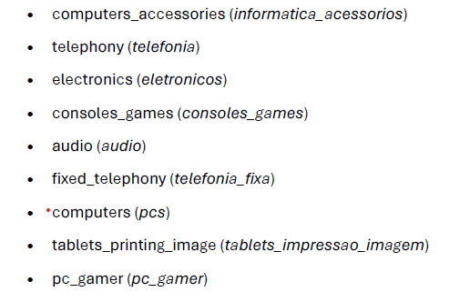
Magist Tech Categories (9 out of 74)

Slide 15
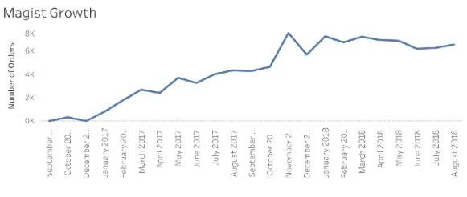
Magist Growth (2016 - 2018)
BACK

Slide 16
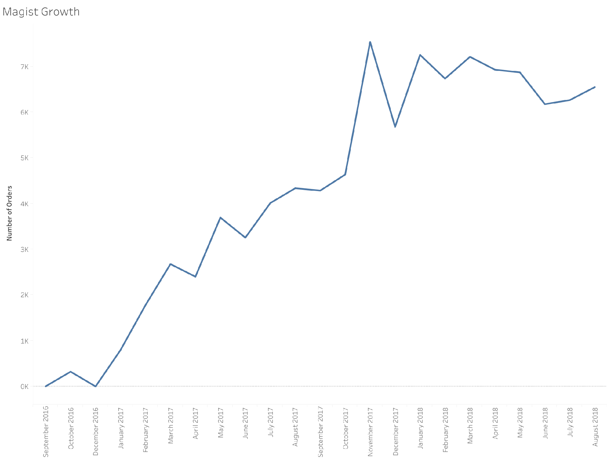

Slide 17
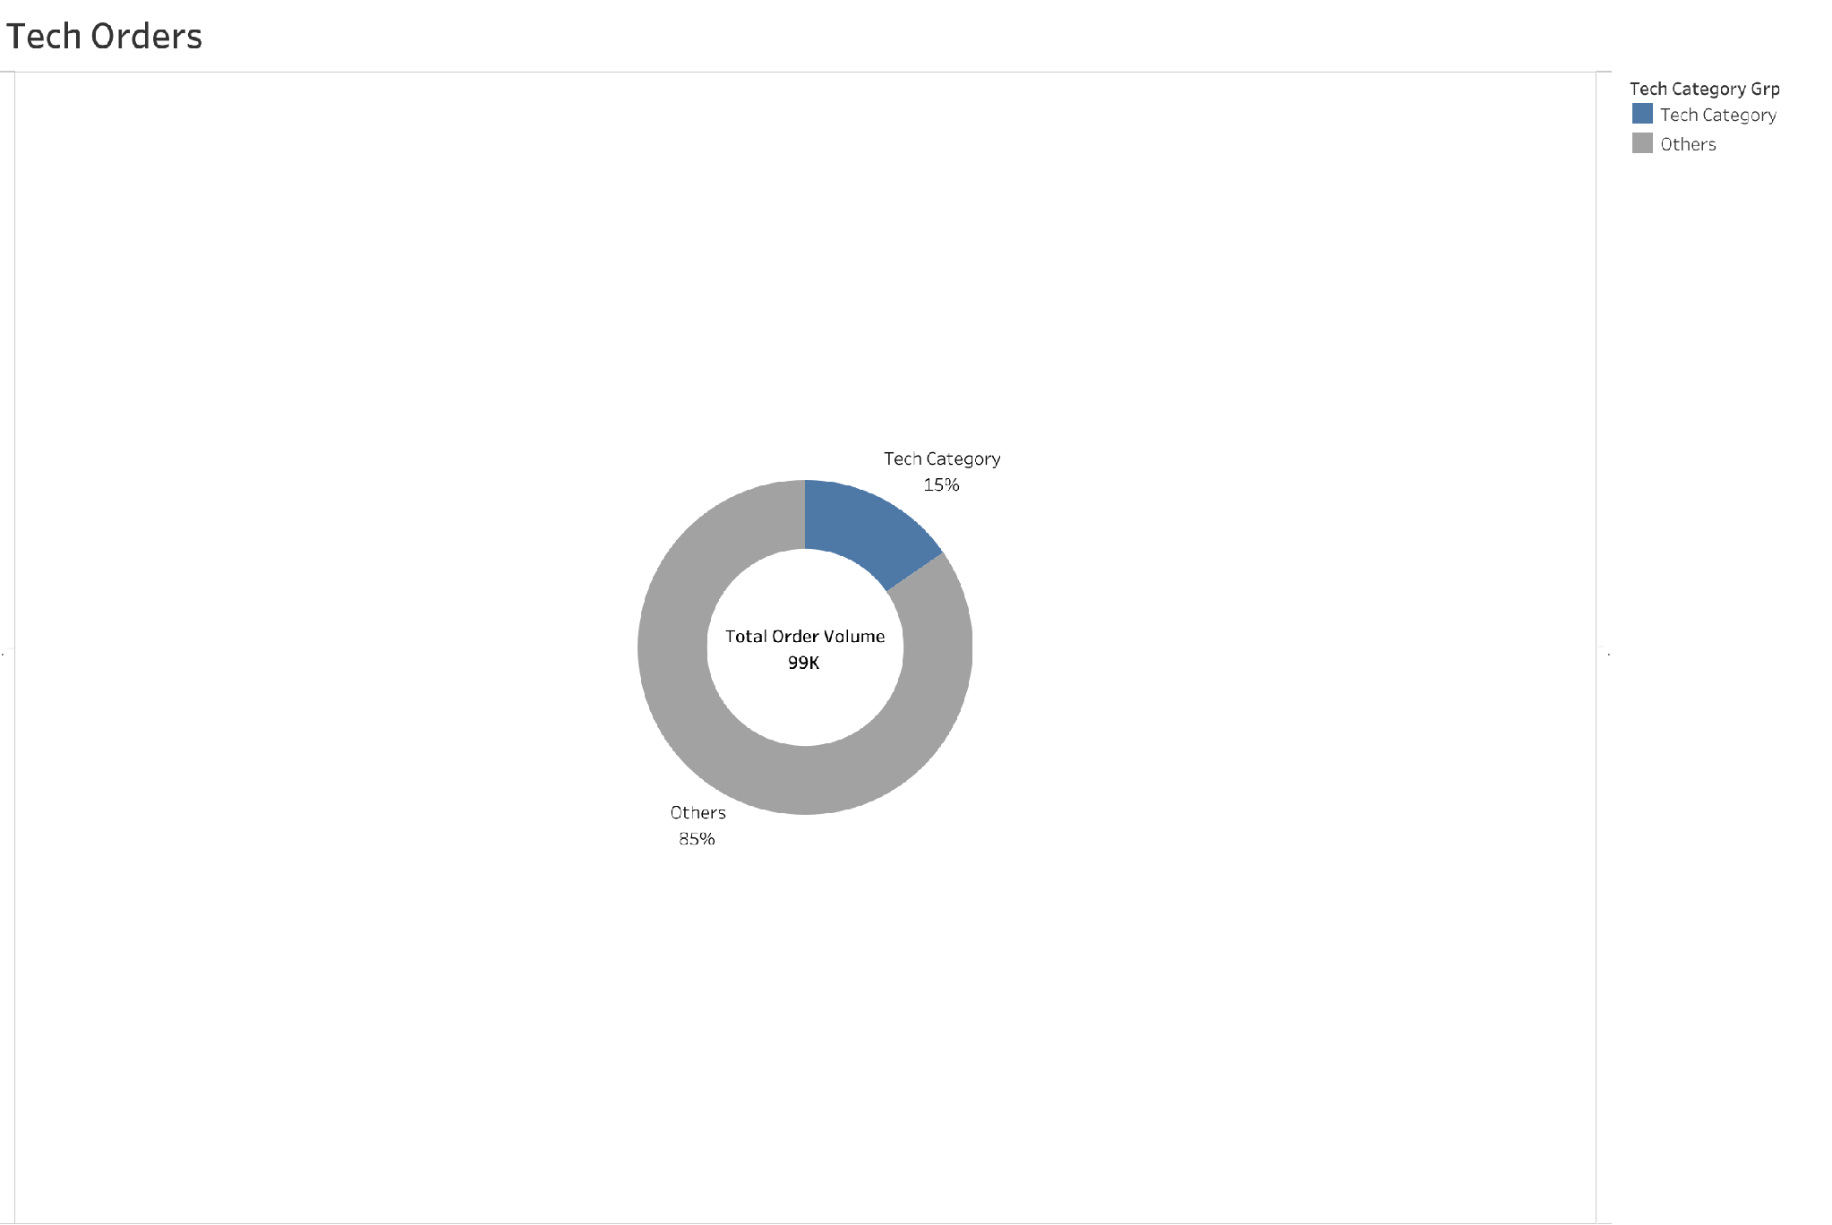

Slide 18
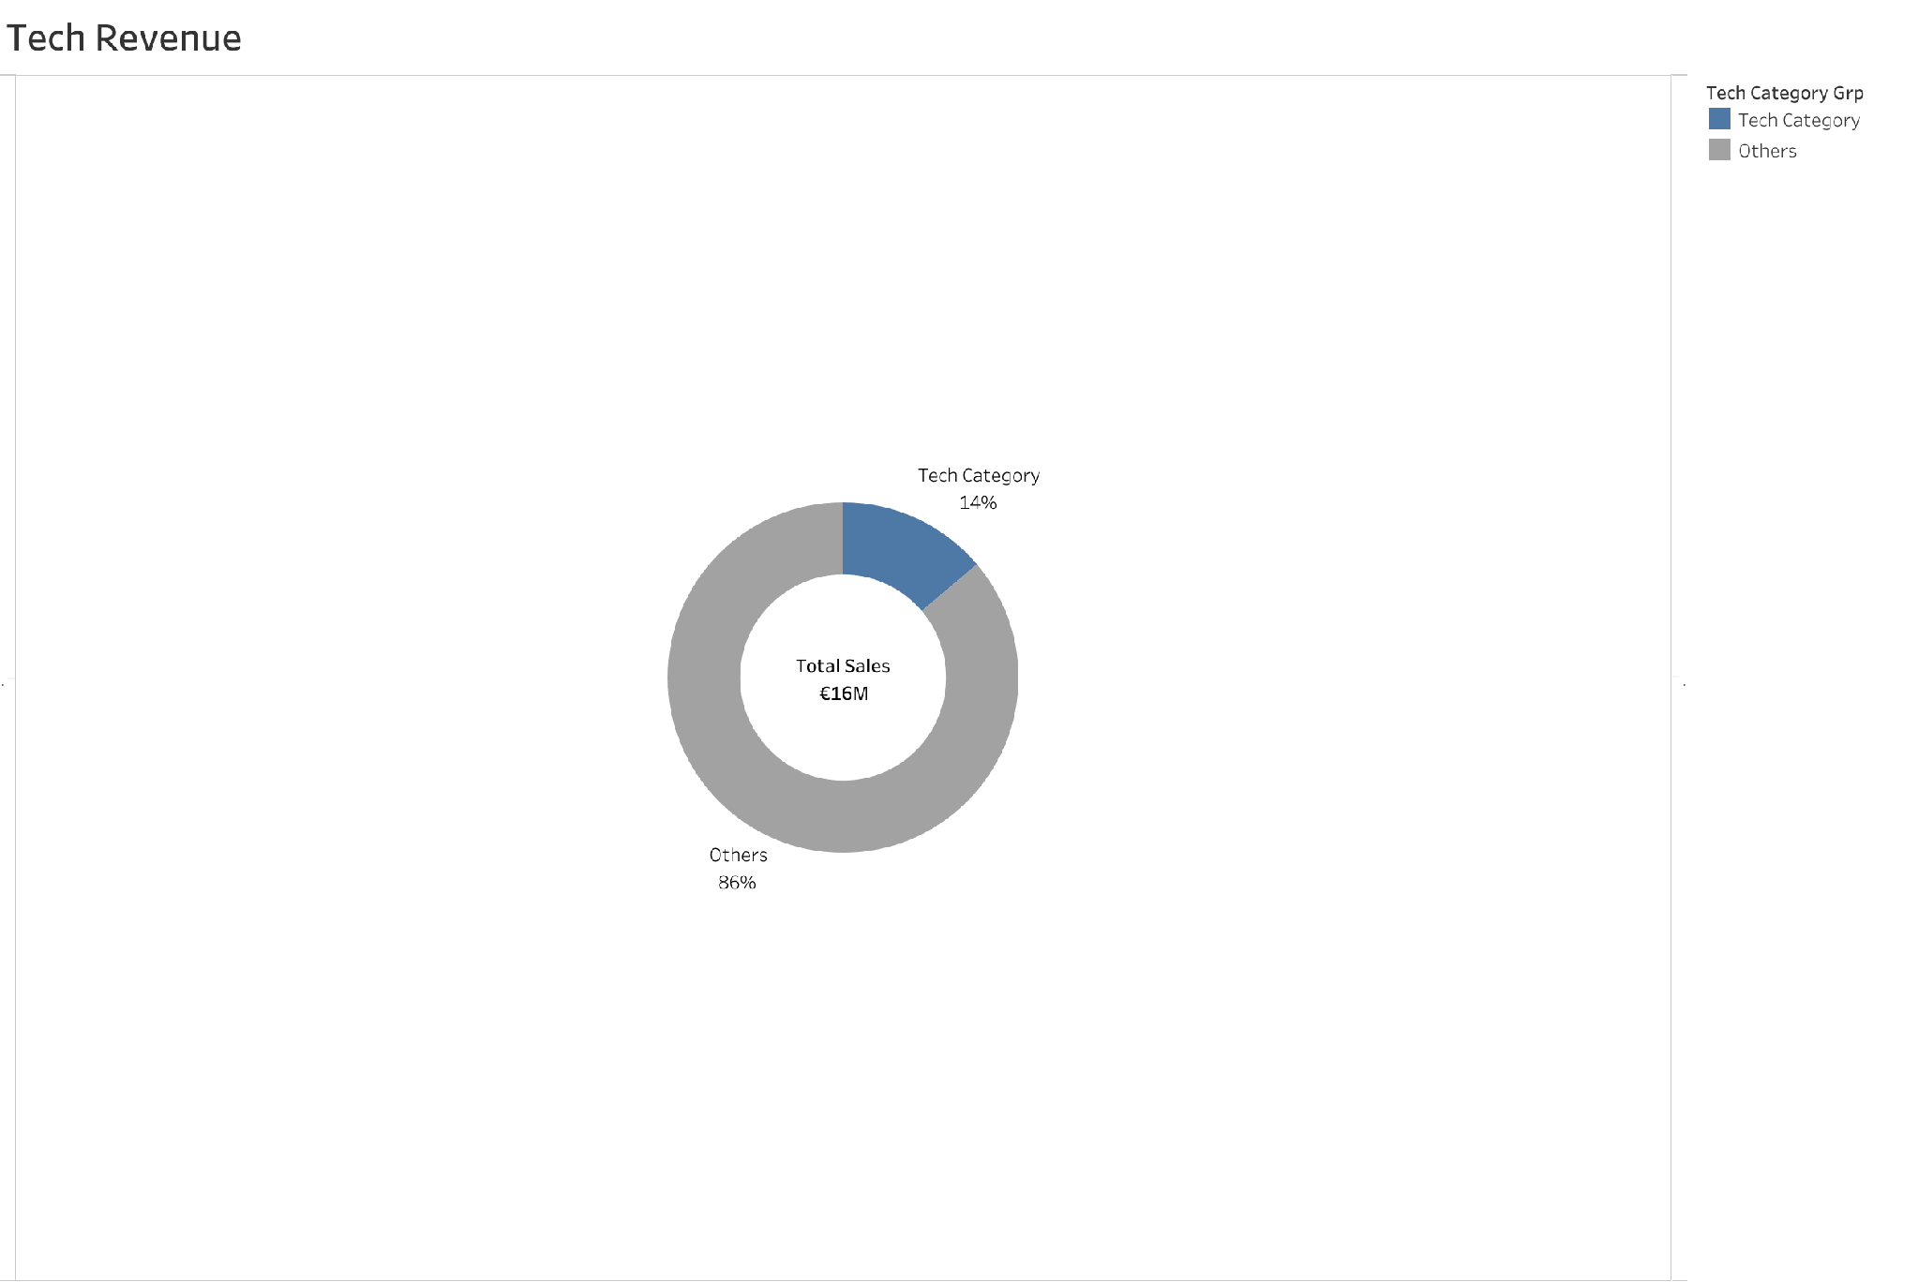

Slide 19
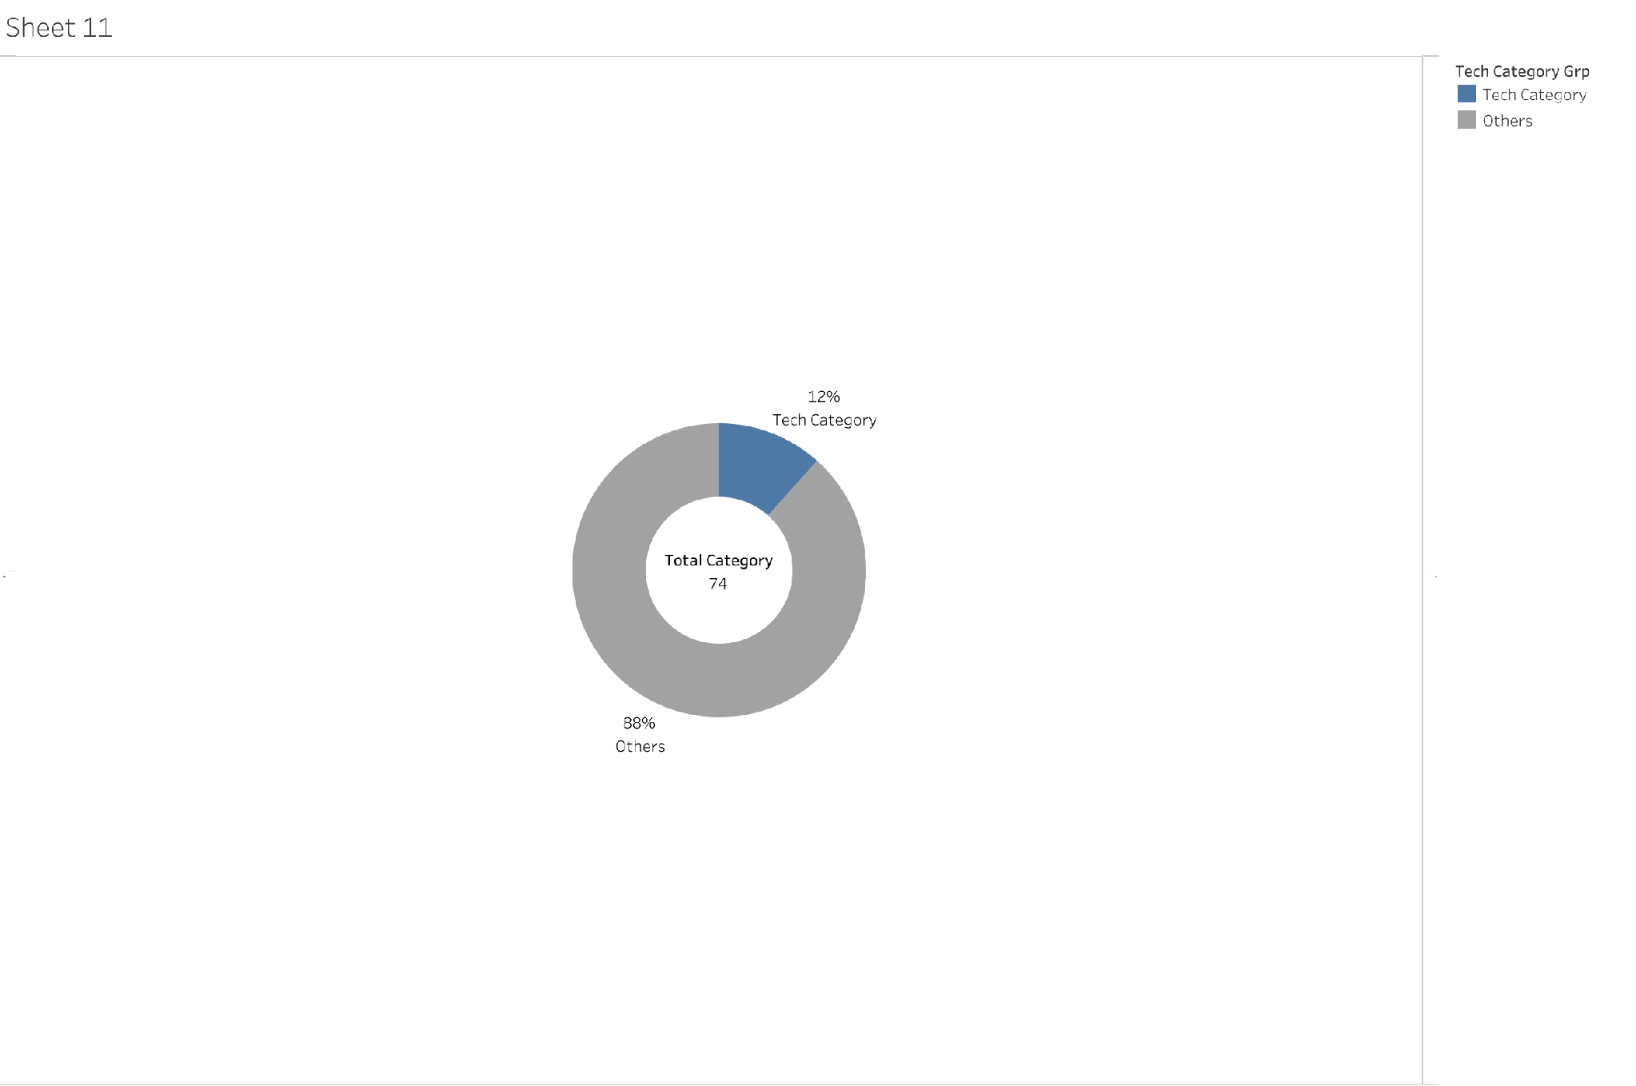

Slide 20
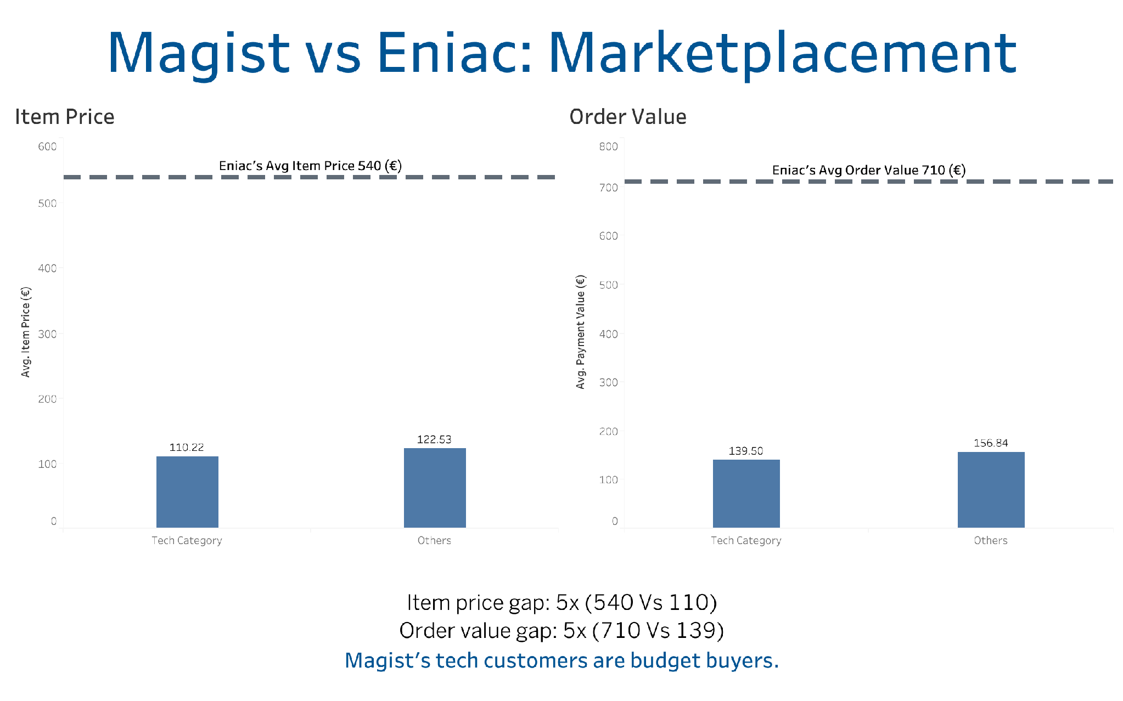

Slide 21
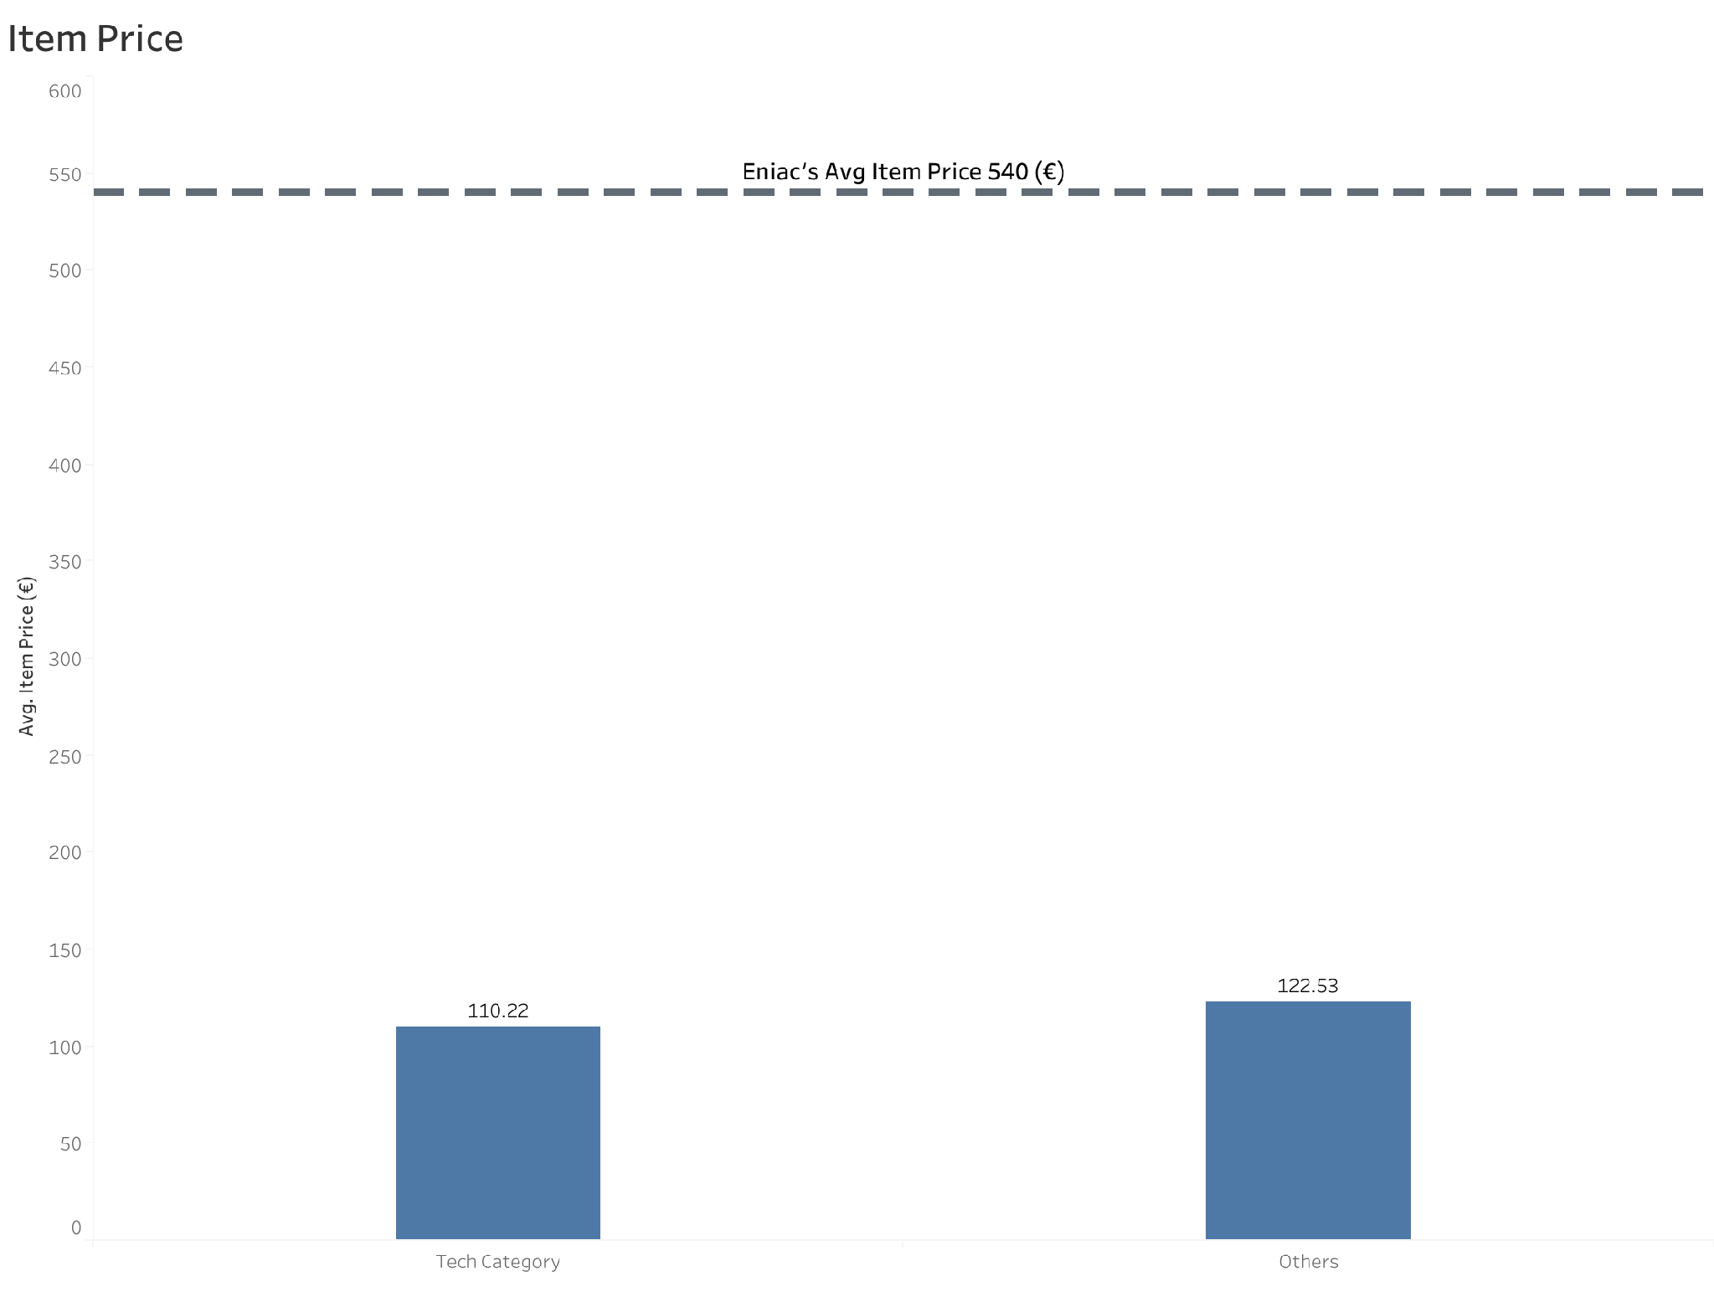

Slide 22
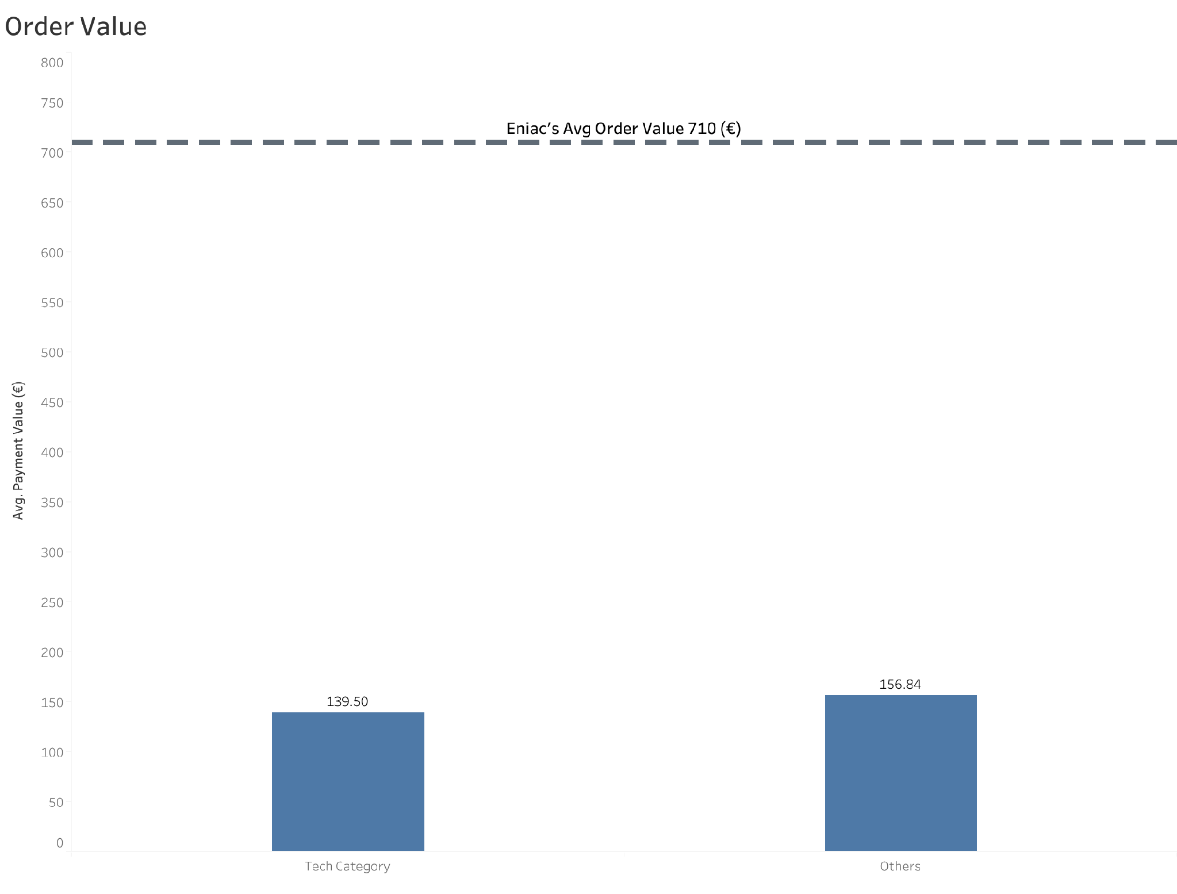

Slide 23
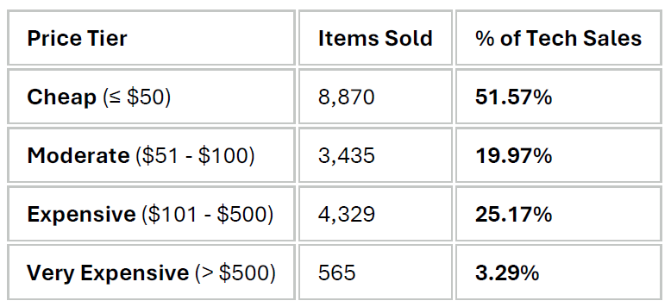
Magist Tech Products - Segmentation
BACK

Slide 24
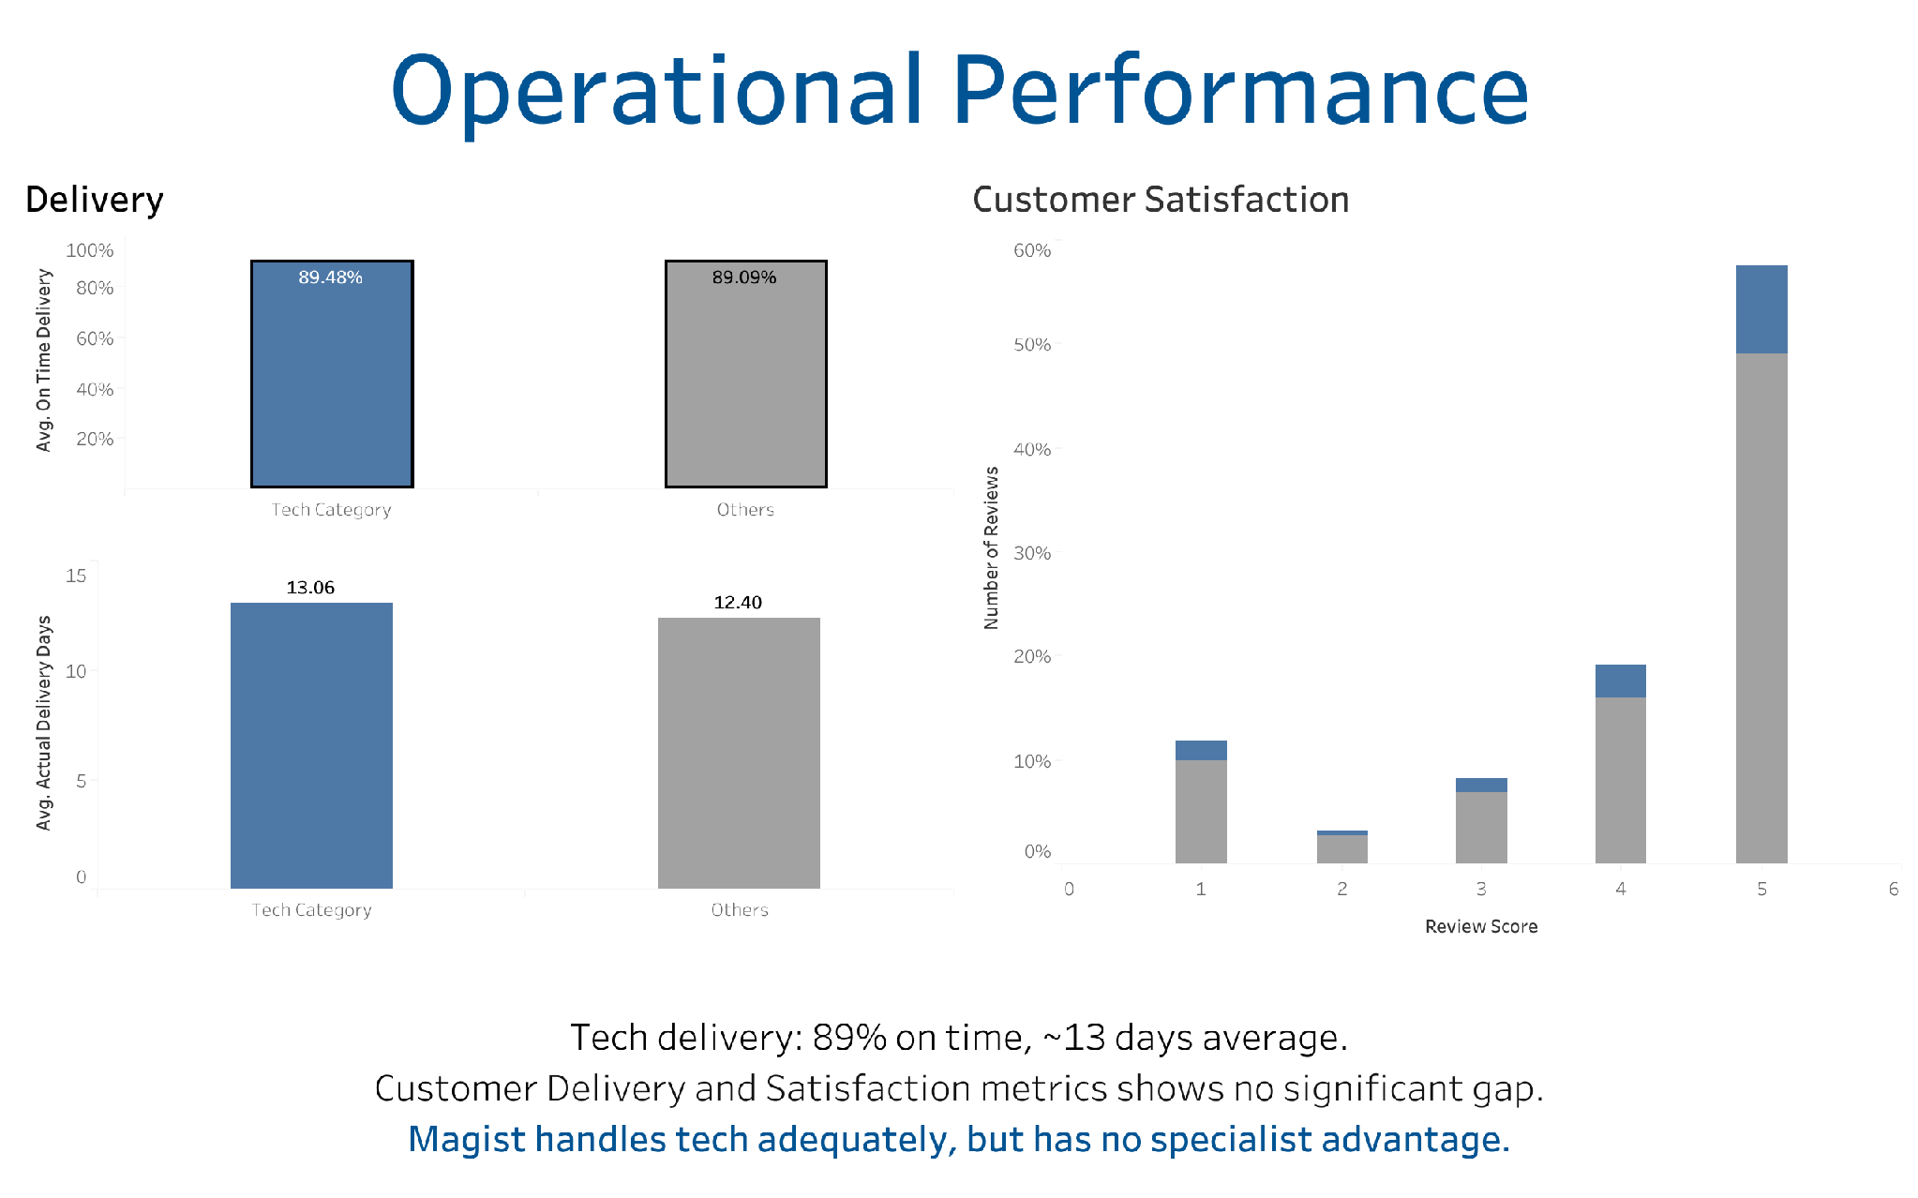

Slide 25
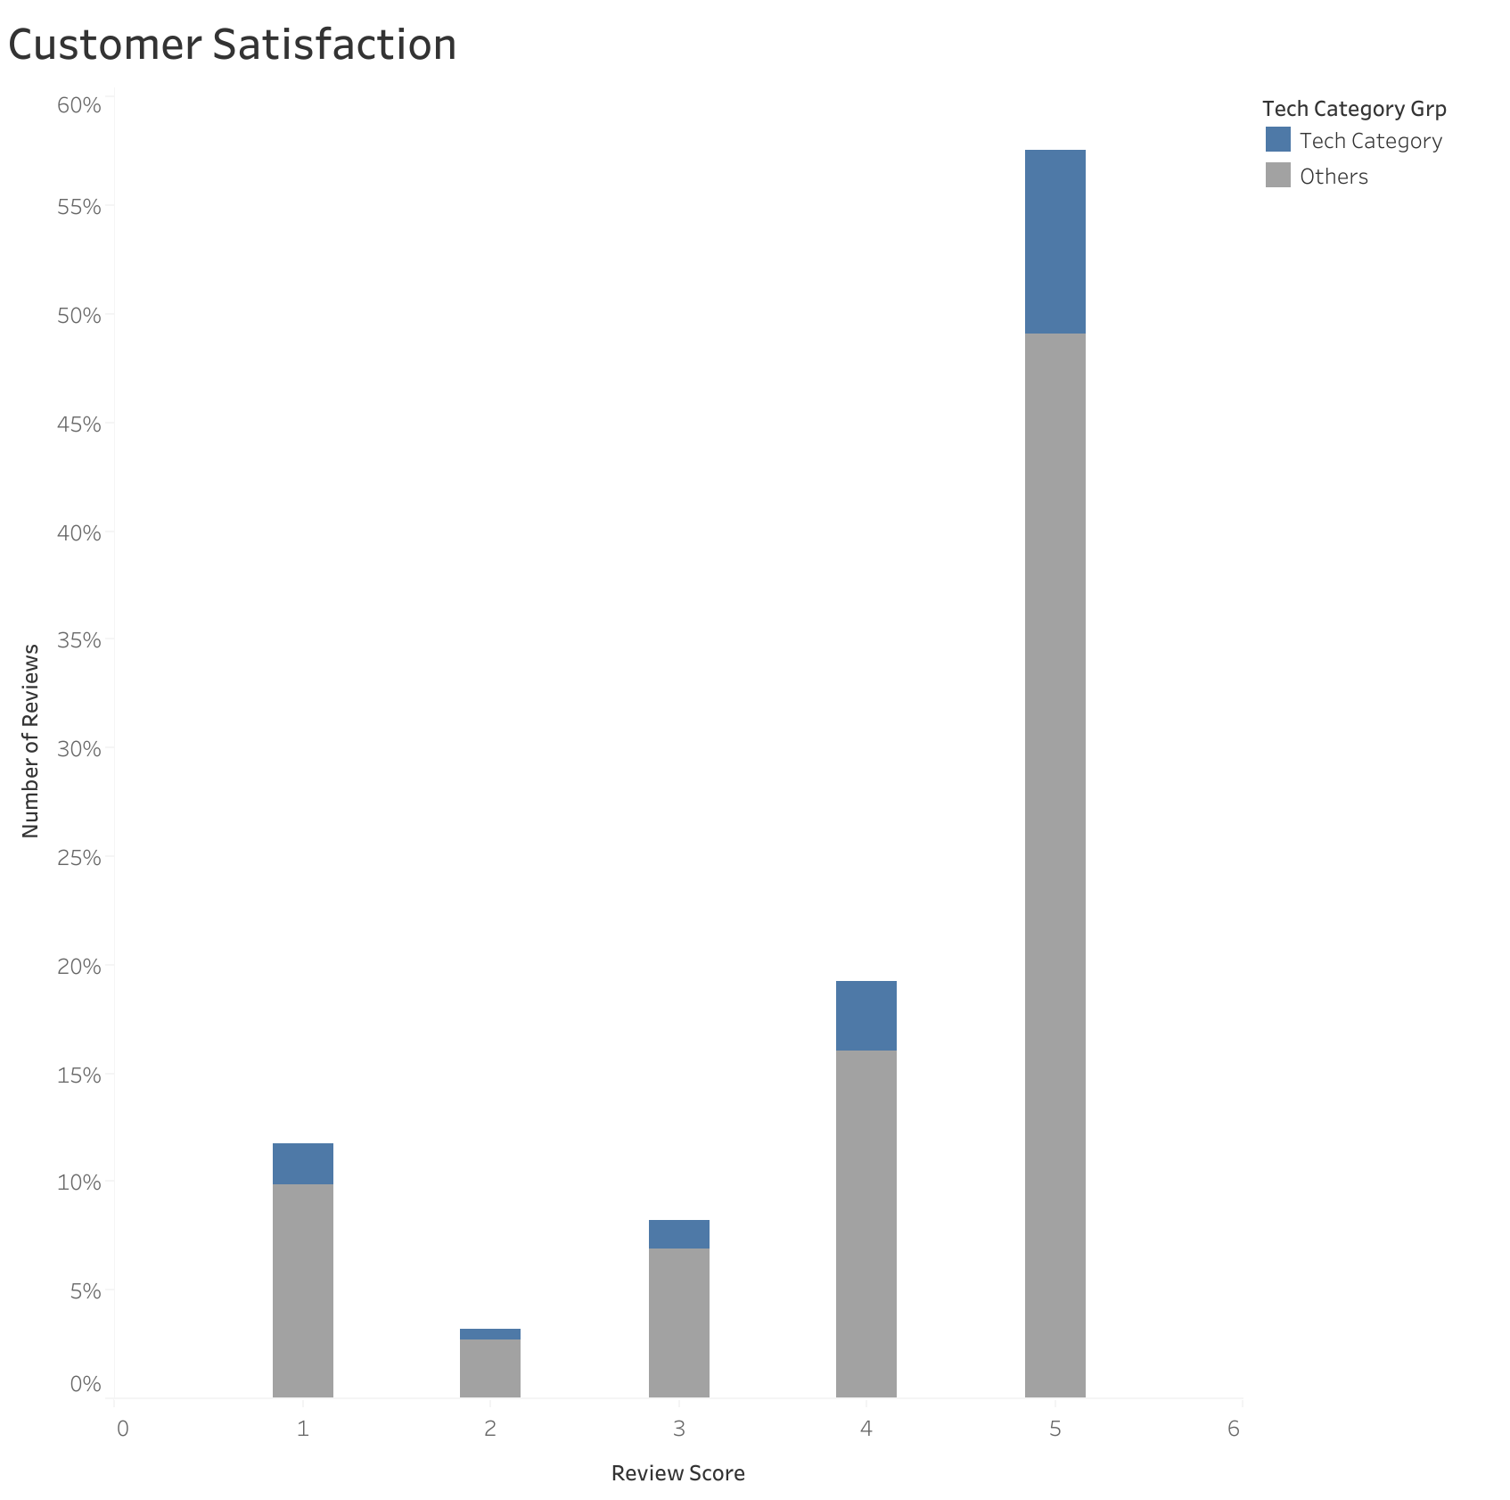

Slide 26
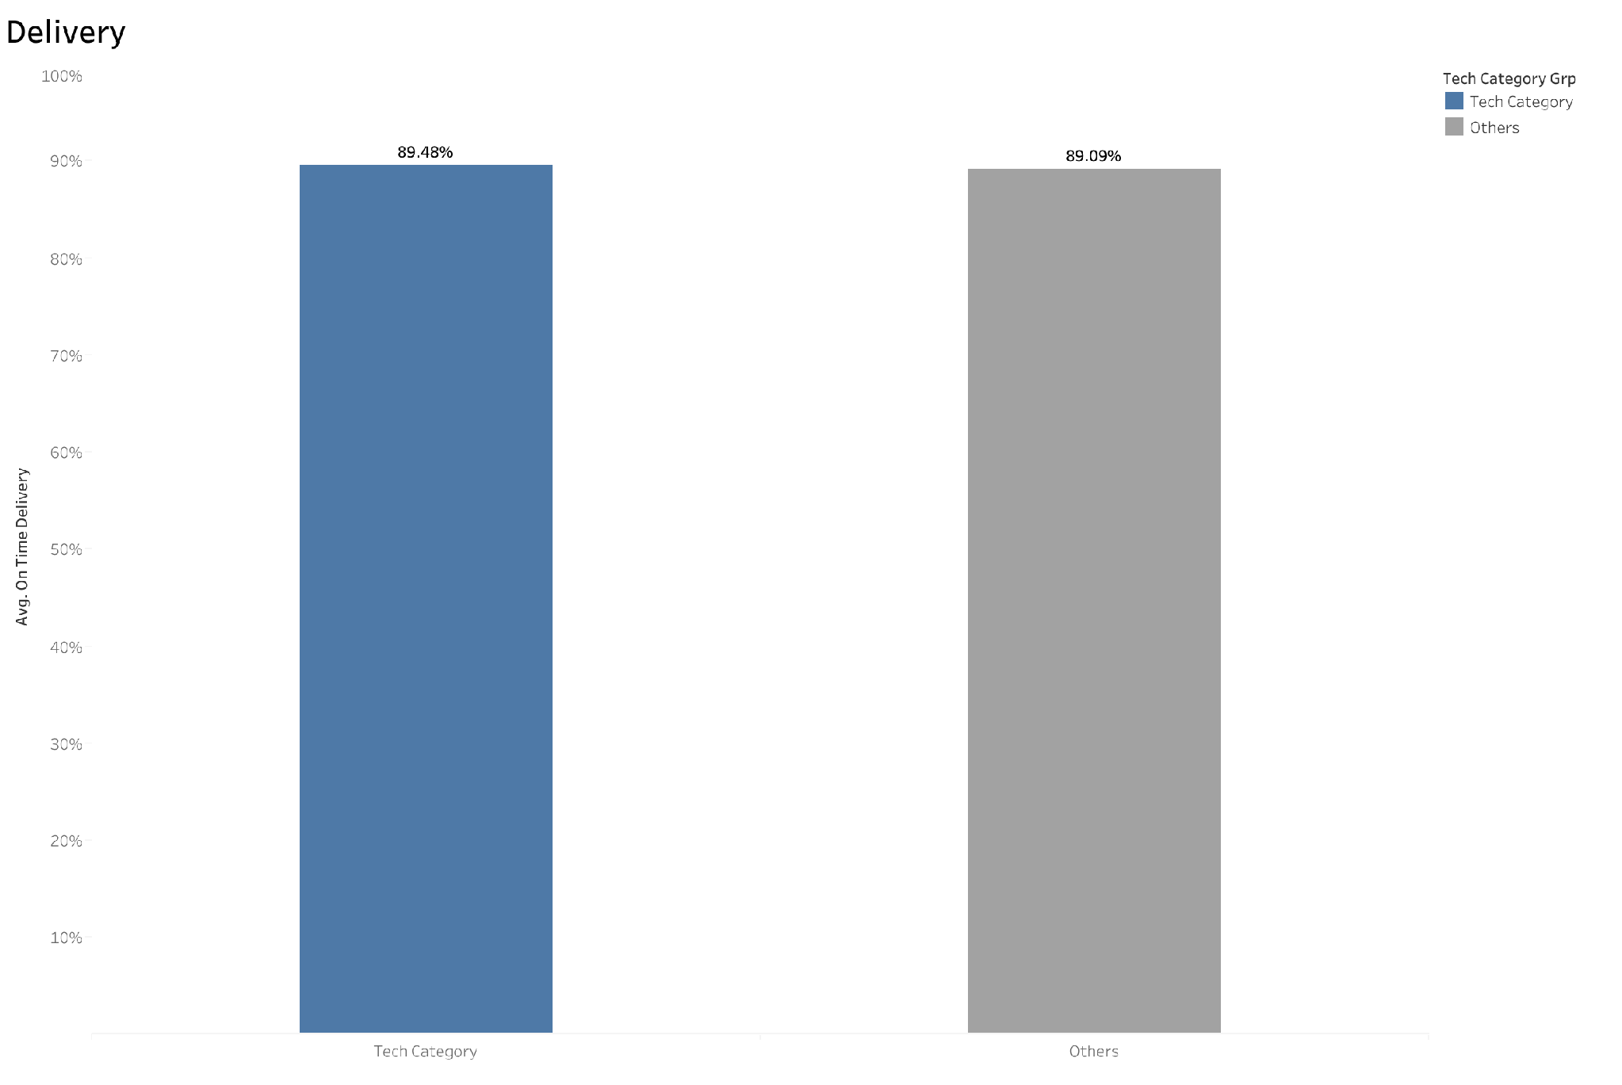

Slide 27
